Slide 1
ENTERPRISE CLOUD INFRASTRUCTURE & RESILIENCE
Azure Backup Restore Validation for 20 Production VMs
Standardizing protection policies, verifying application-consistent snapshots, and proving operational recoverability across critical workloads.
Hackathon Engineering Presentation • Team Solution Architecture

Slide 2
EXECUTIVE SUMMARY
Proving Recoverability, Not Just Backup Jobs
20
100%
Zero
Production Virtual Machines
Policy Standardization
Disaster Recovery Guesswork
Unified under centralized vault policies.
Eliminates configuration drift and blind spots.
Isolated sandbox restores confirm data integrity.

Slide 3

CONTEXT & SCOPE
The Operational Reality of Cloud Backups
Backup Success ≠ Recovery Assurance
A completed job proves data was copied, not that it will boot cleanly.
Target Enterprise Scale
20 heterogeneous VMs spanning SQL, web microservices, and file shares.
Strict Compliance Demands
Requires provable recovery verification records for enterprise audit.

Slide 4
PROBLEM STATEMENT
Why Conventional Backup Strategies Fail
Unverified Snapshots
Policy Inconsistency
Untested Recovery RTO
Latent database corruption undetected until disaster strikes.
Disparate retention rules causing gaps during catastrophic outages.
Unknown restore times violating enterprise SLA agreements.

Slide 5
CORE PHILOSOPHY
Backup Success vs. Guaranteed Recovery
Backup Mindset
Validation Protocol
• Focuses only on snapshot completion
• Boots VMs in isolated sandboxes
• Assumes storage snapshot integrity
• Verifies app consistency & DB state
• Zero validation of OS bootability
• Validates disk mounting & networking
• Catastrophic risk during live failovers
• Delivers 100% auditable proof

Slide 6
DELIVERABLES
Four Pillars of Our Solution
01 / GOVERNANCE
02 / CONSISTENCY
03 / ISOLATION
04 / AUDIT
Unified Vault Policy
VSS & App Quiescing
Sandbox Verification
Automated Proof
Centralized policy applied to all 20 production VMs.
Application-consistent recovery points for databases.
Non-disruptive restoration inside quarantined VNets.
Structured evidence logging for disaster recovery audit.

Slide 7

ARCHITECTURE BLUEPRINT
Azure Backup Tiered Infrastructure
Snapshot Tier (Instant Restore)
Local disk snapshots retained 2 days for sub-hour RTO.
Vault-Standard Storage Tier
Geo-redundant encrypted storage for 30-day compliance retention.
Recovery Services Vault Control Plane
Centralized orchestration with Role-Based Access Control (RBAC).

Slide 8
TARGET ENVIRONMENT
20 Production Workloads Breakdown
Workload Tier | VM Count | Guest OS Profile | Criticality | Consistency Mode
Database Clustered | 4 VMs | Windows Server 2022 / MSSQL | Tier 0 (Mission Critical) | App-Consistent (VSS)
Application APIs | 8 VMs | Ubuntu Linux 22.04 LTS | Tier 1 (High) | File-Consistent / Scripts
Frontend Web | 5 VMs | Windows Server & IIS | Tier 2 (Medium) | App-Consistent (VSS)
Shared Utilities & DNS | 3 VMs | Linux & Domain Services | Tier 2 (Infrastructure) | Crash-Consistent OK

Slide 9
STANDARDIZATION
One Baseline Policy Across All 20 VMs
Daily Schedule
Instant Recovery
Vault Retention
Executed daily at 23:00 UTC off-peak hours.
2-day local snapshot tier for zero-wait restores.
30 daily recovery points kept in vault storage.

Slide 10
SLA TARGETS
Agreed Recovery Time & Point Objectives
< 24h
< 4h
100%
Target RPO
Target RTO
Test Coverage
Maximum tolerable data loss interval.
Maximum time to full service recovery.
All application tiers validated regularly.

Slide 11

DEEP-DIVE ARCHITECTURE
Application-Consistent Snapshot Pipeline
1. Quiesce Workload Memory
VSS instructs SQL/Exchange to flush memory transactions.
2. Coordinate Storage Snapshot
Azure hypervisor takes instantaneous block-level delta snapshot.
3. Thaw & Background Transfer
Applications resume active I/O while blocks transfer to vault.

Slide 12
TECHNICAL COMPARISON
Snapshot Consistency Evaluation
Crash-Consistent Mode
Application-Consistent Mode
• Captures disk bytes as if power cord pulled.
• Coordinated with guest OS writers.
• In-flight RAM transactions are lost.
• Flushes pending transactions to disk.
• Requires DB recovery checks on reboot.
• Instant, zero-repair operational boot.
Suitable only for stateless web servers.
Mandatory for SQL and financial ledgers.

Slide 13
GUEST CONFIGURATION
Windows VSS Health Verification
VSS Writer Status
Azure VM Agent
Shadow Storage Space
Confirm Stable state for System and SQL writers.
Ensure Windows Azure Guest Agent is healthy.
Maintain minimum 15% free disk for shadow copies.

Slide 14
LINUX WORKLOADS
Linux Quiescing with Pre/Post Scripts
STEP 01
STEP 02
STEP 03
Pre-Script Quiesce
Disk Snapshot
Post-Script Thaw
Executes pre.sh to lock MySQL/PostgreSQL databases.
Azure hypervisor snapshots frozen file system state.
Executes post.sh to release locks and continue operations.

Slide 15
VALIDATION FRAMEWORK
The 3-Phase Restore Validation Strategy
1. Sampling Strategy
2. Quarantined Testing
3. Verification Criteria
Test high-risk workloads every cycle to optimize quota.
Restore into air-gapped sandboxes with zero IP conflicts.
Validate OS boot, DB mount, and log zero errors.

Slide 16
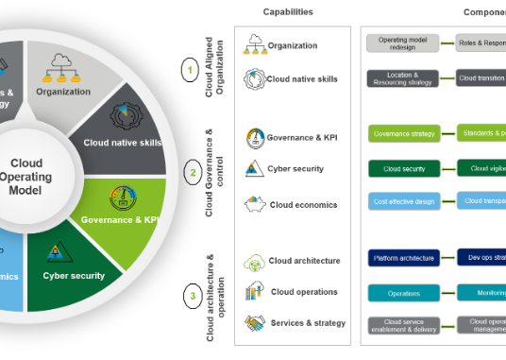
ZERO PRODUCTION COLLISION
Quarantined Restore Virtual Network
Isolated Test Subnet
Non-routable VNet preventing IP collisions with production.
Strict NSG Inbound/Outbound Rules
Blocks outbound mailers, prod database triggers, and APIs.
Ephemeral Life Cycle
Automated post-validation deprovisioning saves cloud spend.

Slide 17
STANDARD OPERATING PROCEDURE
The 4-Step Validation Lifecycle
STAGE 1
STAGE 2
STAGE 3
STAGE 4
Select Point
Provision VM
Health Check
Audit & Clean
Pick app-consistent point from Recovery Services vault.
Restore managed disks and attach into isolated sandbox.
Run automated boot checks and verify database mounts.
Export compliance record and tear down test resources.

Slide 18
TESTING ECONOMICS
Risk-Based Workload Sampling
Weekly Rotation
Critical Bias
Quota Guard
Restores 5 VMs per week in controlled rotation.
Tier 0 databases validated in every cycle.
Avoids subscription vCPU and disk throttling.
Zero tolerance for stale database snapshots.
100% environment coverage every month.
Protects production capacity allocations.

Slide 19
QUALITY ASSURANCE
Validation Pass / Fail Checkpoints
Verification Layer | Target Object | Automated Command | Pass Criteria
Hardware / Fabric | Azure VM & Disks | Get-AzVMStatus | ProvisioningState: Succeeded
Operating System | Guest Kernel | Boot Diagnostics API | Login Prompt Screen Rendered
Data Volumes | Attached Data LUNs | lsblk / Get-Volume | All Partitions Mounted Read/Write
Application Engine | SQL Server Service | DBCC CHECKDB | Zero Allocation / Consistency Errors

Slide 20
TECHNICAL EVIDENCE
OS Boot Diagnostics & Telemetry
Boot Diagnostics Screenshots
Captures VM display to confirm no BSOD or kernel panic.
Serial Console Log Stream
Streams systemd boot logs to verify daemon initialization.
Guest Heartbeat Validation
Monitors Azure VM Health status to confirm agent responsiveness.

Slide 21
APPLICATION LEVEL
Deep Workload Health Inspections
Database Mounts
Loopback API Probes
File Checksums
Auto-attach MSSQL MDF/LDF files and execute checksum queries.
Trigger localhost /healthz HTTP endpoints inside sandbox.
Compare SHA-256 hashes of designated canary files.

Slide 22
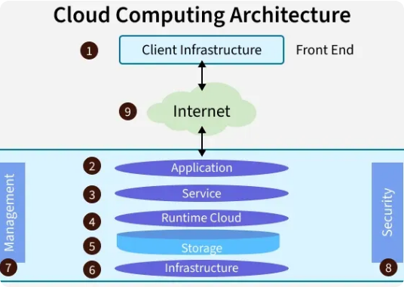
ENGINEERING CHALLENGES
Operational Bottlenecks in Scale Restores
1. Subscription vCPU & Disk Quota Limits
Restoring 20 VMs simultaneously exhausts regional compute cores.
2. Storage Vault Data Egress Bottlenecks
Hydrating terabytes from vault tier creates network transfer lag.
3. Windows VSS Writer Timeouts
High write I/O during backup windows causes snapshot timeouts.

Slide 23
ENGINEERING SOLUTIONS
Bottleneck Mitigation Architecture
Unmitigated Risk
Engineered Mitigation
• Mass restore triggers Azure API rate limits.
• Staggered test batches of 4-5 VMs max.
• Storage replication creates latency spikes.
• Instant Restore tier used for validation.
• VSS freezes produce guest OS timeouts.
• Off-peak schedule with I/O throttling.
• Escalating cloud testing expenses.
• Auto-cleanup saves up to 85% dev test costs.

Slide 24
REMEDIATION PLAYBOOK
Resolving Common VSS Failures
ERROR: VSS_E_WRITER_TIMEOUT
ERROR: PROVIDER_NOT_REGISTERED
ERROR: INSUFFICIENT_STORAGE
Writer Stalled
Agent Corrupt
Diff Area Starved
Restart CryptSvc and Volume Shadow Copy services; re-register DLLs.
Reinstall VMSnapshot extension and restart AzureGuestAgent service.
Allocate dedicated storage volume for shadow copy difference files.

Slide 25
OPERATIONAL RUNBOOK
Incident Response & Disaster Failover Flow
PHASE 01
PHASE 02
PHASE 03
PHASE 04
Incident Declaration
Trigger Automation
Rebind IP & DNS
Production Resume
Declare disaster event and identify affected VM list.
Execute AzCLI parallel restore runbook script.
Update Azure DNS Private Zones to restored NIC IPs.
Release traffic locks and open public routing gates.

Slide 26
EMPIRICAL BENCHMARKS
Measured Restore Times by Storage Tier
Instant Restore Tier (Snapshot Storage)
12 Minutes Average
Standard Vault Storage Tier (Hydration Required)
58 Minutes Average
Geo-Redundant Cross-Region Restore (Secondary Region)
115 Minutes Average

Slide 27
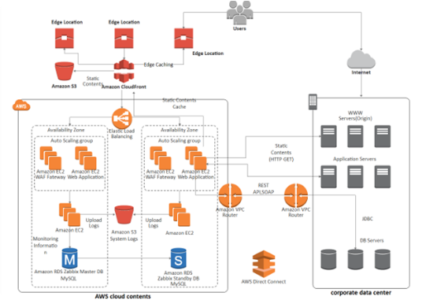
AUDIT READINESS
Compliance Evidence Package
Azure Monitor Log Analytics
Immutable KQL logs capturing all restore job IDs and operators.
Cryptographic Verification Sign-Off
Signed evidence logs satisfying SOC2, ISO 27001, and HIPAA.
Automated Remediation Alerts
Action Groups alert engineers if validation exceeds 120 minutes.

Slide 28
FUTURE EVOLUTION
Post-Hackathon Production Enhancements
Full CI/CD Automation
Chaos Simulation
PowerBI Executive Deck
Integrate Azure DevOps pipelines for scheduled unattended test runs.
Introduce Azure Chaos Studio to test recovery under live disk corruption.
Real-time reporting dashboard displaying VM recovery readiness status.

Slide 29
PROJECT IMPACT
Proven Enterprise Resilience Outcomes
20 / 20
0 Errors
< 60m
VMs Validated
Database Mounts
Full Restores
100% compliance across production.
Guaranteed application consistency.
Far exceeding the 4-hour RTO target.

Slide 30

Recovery Proven. Ready for Production.
Thank you for evaluating our Azure Backup & Restore Validation Architecture for 20 Production Virtual Machines.
Hackathon Solution Presentation • Open for Technical Q&A

Slide 31






Image Sources
https://azure.microsoft.com/en-us/blog/wp-content/uploads/2022/03/acdf7d3b-44b6-4095-bee0-376c1014eccb.webp
Source: azure.microsoft.com
https://blogs.vmware.com/vov/wp-content/uploads/sites/101/2018/12/NSXIaaS.jpg?w=576&h=324&crop=1
Source: blogs.vmware.com
https://www.kore1.com/wp-content/uploads/2026/04/cloud-infra-engineer-workstation-kore1.webp
Source: www.kore1.com
https://cognitivesys.co/wp-content/uploads/2024/10/CloudEngineering.png
Source: cognitivesys.co
https://ecl-ips.com/wp-content/uploads/2019/02/datacenter-286386_640.jpg
Source: ecl-ips.com
https://media.geeksforgeeks.org/wp-content/uploads/20250825133452766889/cloud_computing_architecture.webp
Source: www.geeksforgeeks.org

Slide 32

Image Sources
https://www.optiv.com/sites/default/files/styles/image/public/images/Cloud%20Network%20Security%20Architecture%20Review_img1.png?itok=QHDPMuIu
Source: www.optiv.com

